Slide 1
Drinking Tap Water in the CA East Bay Area
By:
Rebecca Wilder
Marisa Sum

Slide 2
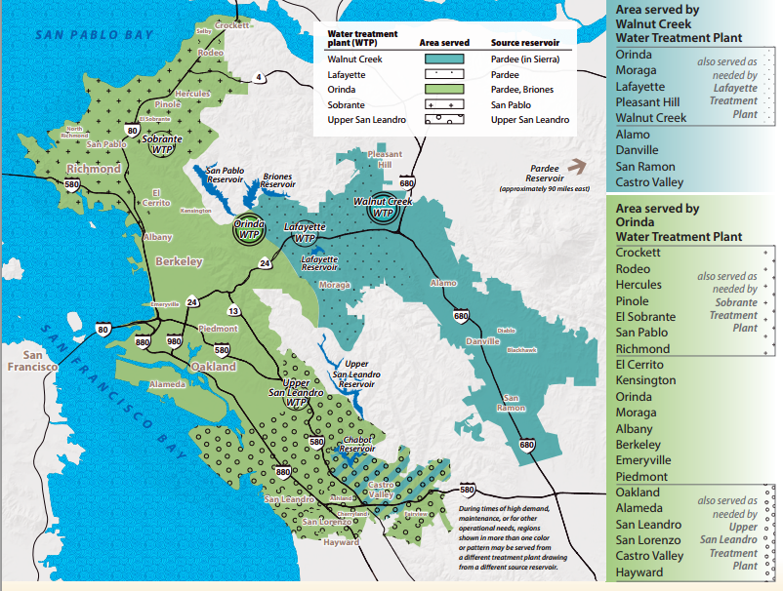
Does the average daily intake of fluoride in East Bay Municipal Utility District (EBMUD) tap water cause adverse health affects?

Slide 3
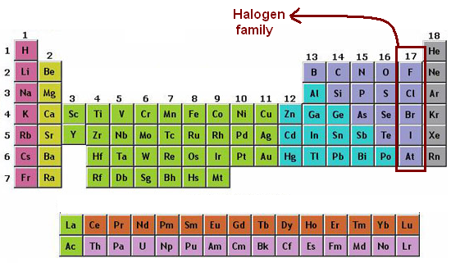
Toxin: Fluoride (F-)/Fluorine
Chemical structure: F-
Group 17 on Periodic Table: Halogens
Toxic, non-metallic elements that tend to attract electrons to themselves, making them electronegative
Fluorine is the element; Fluoride is the inorganic ionic form
Fluoride is most reactive halogen
Readily available to bond or form diatomic molecules (F2)
Fluoride mimics nucleophilic hydroxide ions (-OH)
Hydrofluoride (HF) in nature because F- is a weak base and attracts hydrogen (H+)

Slide 4
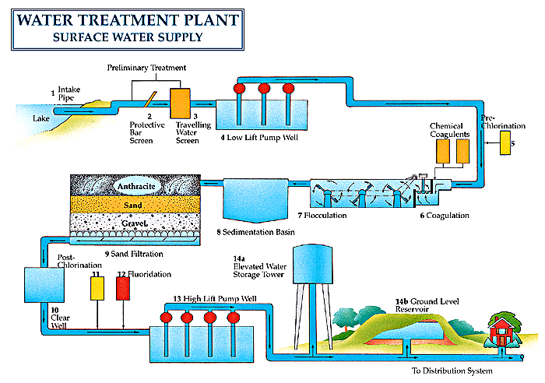

Slide 5
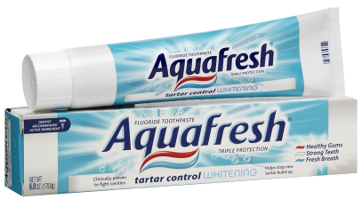
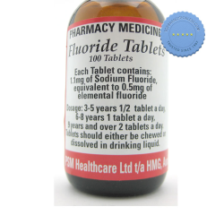
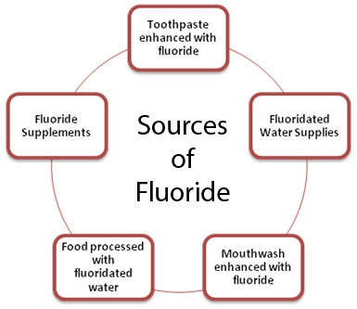
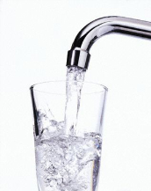
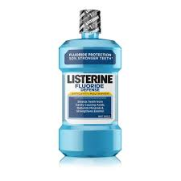
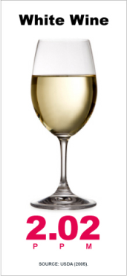
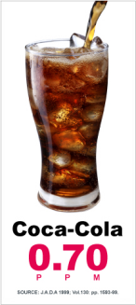
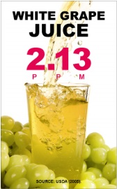
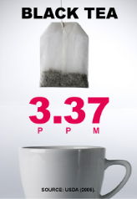


Fluoride Exposure
Fluoride is found in:
Several medicines that are used for treating skin diseases (e.g., flucytosine, an antifungal) and some cancers (e.g., fluorouracil, an antimetabolite).
Toothpaste
Mouthwash
Drinking water
Supplements
Infant formulas
Boiled water concentrates (F-): Tea, coffee, soups
Earth’s crust
Glass and steel waste water manufacturing
Vegetables, fruit, nuts
Water fluoridation usually is accompished by adding sodium fluoride (NaF), Calcium fluoride (CaF), fluorosilicic acid (H₂SiF₆), or sodium fluorosilicate (Na₂SiF₆) to drinking water.
NaF: waste product of aluminum and is used in rat poisons

Slide 6
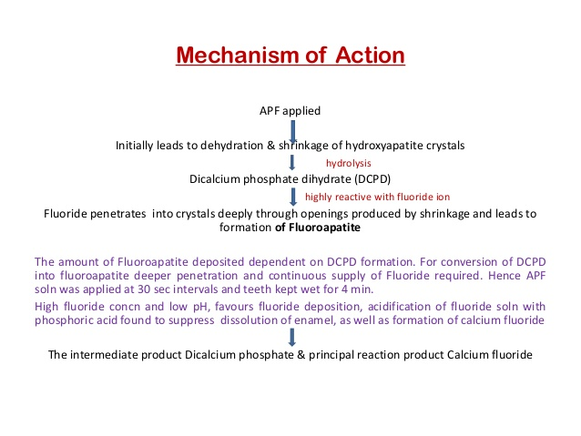
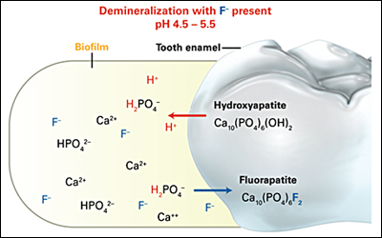
Fluoride’s Method of Action
Strengthens teeth from infancy to adolescence (developing years)
Tooth enamel demineralization and remineralization:
Demineralizing tooth enamel’s hydroxyapatite crystals (Ca10(PO4)6(OH)2 and remineralizing the enamel with fluorapetite crystals instead – chemical conversion process
Fluorapatite crystals in tooth enamel shows to decrease tooth decay due to plaque acids

Slide 7
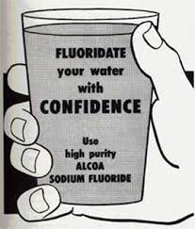
Adverse Affects of Fluoride in the Body
Target organs of injury are: Kidneys, GI tract
Crosses cell membrane and goes into skeletal, cardiac, muscle and red blood cells
Ingested in stomach to hydrofluoric acid, which has corrosive affect on GI lining
Toxicity can cause hemorrhage in gastric mucosa, ulcers, erosions, and edema
Fluorosis: (Chronic toxicity) An abnormal condition (such as mottling of the teeth) caused by an excessive intake of fluorine during the development period of the permanent teeth.

Slide 8
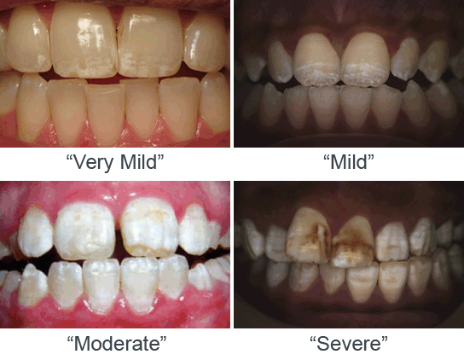
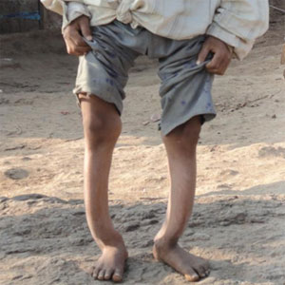
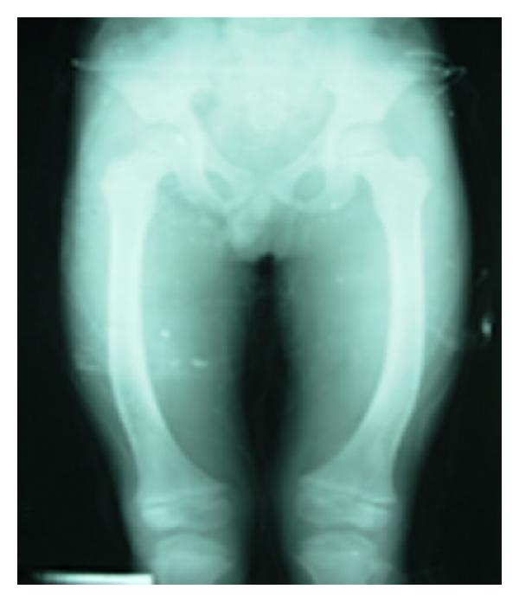
Dose-Response/Toxicity of Fluoride
Acute Toxicity: 0.1mg/kg-0.3 mg/kg (~0.1 – 0.3 ppm) | Chronic Toxicity: Numerically difficult to verify. Depends on weight, lifestyle & health of person.
Symptoms that mimic those of other, common ailments such as: Headache, upset stomach, nausea, flu, thirst, abdominal pain, so are often undiagnosed as fluoride toxicity or poisoning. As noted in the Journal of Public Health Dentistry: “Estimating the incidence of toxic fluoride exposures nationwide also is complicated… symptoms may be attributed to colic or gastroenteritis, particularly if they did not see the child ingest fluoride.” | Organs of injury: endocrine system, brain, heart, kidneys, pineal gland Symptoms include: Chronic fatigue Headaches Dryness of the throat Urinary tract irritation Fluorosis: Aches and stiffness in muscles/bones (arthritic-like) Dental fluorosis Skeletal fluorosis: ligamentous calcification of lower back, neck, jaws, arms, shoulders, legs Muscle weakness Muscle spasms (involuntary twitching) Tingling sensations in fingers (especially) and feet Gastrointestinal disturbances Mouth sores , abdominal pains, blood in stools, diarrhea, bloated feeling (gas), Constipation Tenderness in stomach area, feeling of nausea (flu-like symptoms) Pinkish-red or bluish-red spots (like bruises, but round or oval) Skin rash or itching, especially after showers or bathing. Brain Loss of mental acuity and ability to concentrate, depression, excessive Nervousness, dizziness, tendency to lose balance Visual disturbances Temporary blind spots in field of vision, retinal damage

Slide 9
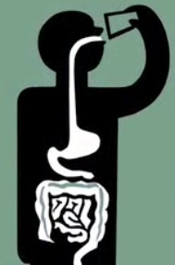
Fluoride Metabolism and Elimination
Fluoride metabolism:
Fluoride is converted to hydrofluoric acid in gut and absorbed across epithelial lining into blood stream
In blood: moves on to elimination or continued absorption
Most F- ions settle in teeth and bones
Fluoride is eliminated by: kidneys, feces, sweat, saliva
Mostly excreted by kidneys
Remainder excreted in feces, sweat and saliva
Fluoride biological half-life is: ~3.5 hrs (2-5 hrs)
If you drink 5 cups of water/day (16 waking hrs) =
Circulating <0.05 ppm of fluoride
If you drink 8 cups of water/day (16 waking hrs) =
Circulating <0.1 ppm of fluoride

Slide 10
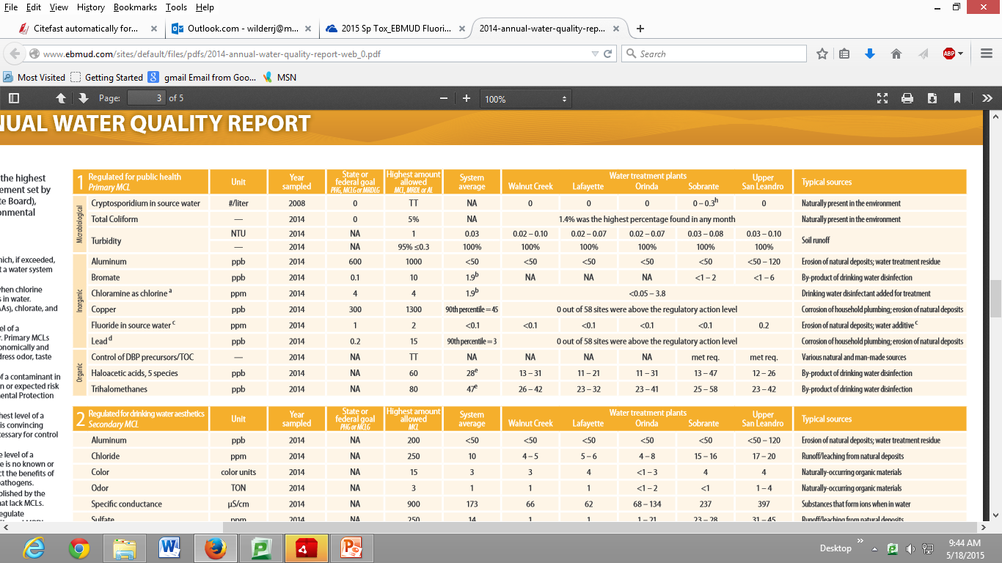
Risk and Prevalence
Risk of exposure to Fluoride: High- Unavoidable
Prevalence of exposure to public: high, but less than mandated.
http://www.ebmud.com/sites/default/files/pdfs/2014-annual-water-quality-report-web_0.pdf

Slide 11

Does the average daily intake of fluoride in East Bay Municipal Utility District (EBMUD) tap water cause adverse health affects?
It is complicated!
Acute toxicity often goes undiagnosed so prevalence unknown, more due to toothpaste ingestion
Chronic toxicity unlikely
Depends on existing health – Renal failure decreases F- elimination
Consider accumulation of F- in tap water from all sources – dental hygiene, consumption of processed foods and produce, water for drinking and for cooking

Slide 12
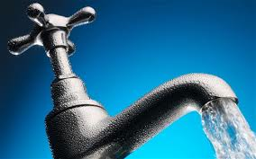
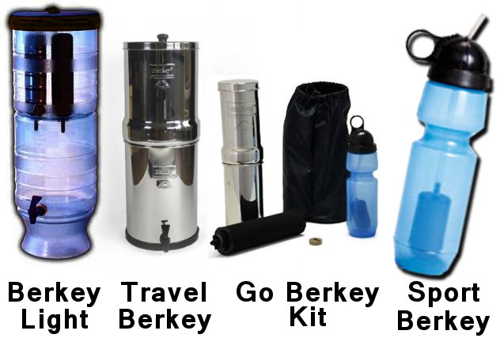
Alternatives to EBMUD Tap Water
Reverse-Osmosis machines, sink and shower filters and household systems $300-$3,000 www.purewaterfreedom.com
Flouride Free Bottled water:
Crystal Geyser: “does not artificially add any minerals to our spring water. We do have a small amount of naturally occurring fluoride, which ranges from 0 to 0.7 parts per million, depending on the location of the spring source.”
Berkey water filter $200-$500 http://www.berkeywater.com/

Slide 13
Citations
Wefel, J., & Faller, R. (2014, April 7). A History and Update of Fluoride Dentifrices. Retrieved from http://dentalcare.com/media/en-US/education/ce94/ce94.pdf
A Review by Foulkes RG, "Investigation of inorganic fluoride and its effect on the occurrence of dental caries and dental fluorosis in Canada - final report", Fluoride, 1995 Aug, 28:3, 146-14
ATSDR - Public Health Statement: Fluorides, Hydrogen Fluoride, and Fluorine. (n.d.). Retrieved from http://www.atsdr.cdc.gov/PHS/PHS.asp?id=210&tid=38
Chemistry FAQs - Physical Science Frequently Asked Questions. (n.d.). Retrieved from http://chemistry.about.com/od/chemistryfaqs/f/what-is-fluoride.html
Fluoridation of drinking water and chronic kidney disease: absence of evidence is not evidence of absence. (n.d.). Retrieved from http://ndt.oxfordjournals.org/content/23/1/411.1.full
Fluoride - Toxipedia. (n.d.). Retrieved from http://www.toxipedia.org/display/toxipedia/Fluoride
Fluoride Action Network | FAN’s Grocery Store Guide: 7 Ways to Avoid Fluoride in Beverages and Food. (n.d.). Retrieved from http://fluoridealert.org/content/grocery_guide/
Group 17: The Halogens - Chemwiki. (n.d.). Retrieved May 18, 2015, from http://chemwiki.ucdavis.edu/Inorganic_Chemistry/Descriptive_Chemistry/p-Block_Elements/Group_17%3A_The_Halogens
Akiniwa, K. (1997). Re-examination of acute toxicity of fluoride. Fluoride 30: 89-104.
Gessner BD, et al. (1994). Acute fluoride poisoning from a public water system. New England Journal of Medicine 330:95-9
Penman AD, Brackin BT, Embrey R. (1997). Outbreak of acute fluoride poisoning caused by a fluoride overfeed, Mississippi, 1993. Public Health Reports 112:403-9.
Petersen LR, et al. (1988). Community health effects of a municipal water supply hyperfluoridation accident. American Journal of Public Health 78: 711-3.
Shulman JD, Wells LM. (1997). Acute fluoride toxicity from ingesting home-use dental products in children, birth to 6 years of age. Journal of Public Health Dentistry 57: 150-8.
http://www.fluoridefreefairbanks.org/Communities%20Reevaluate%20Fluoridation.html

